Slide 2

Thematic session III/b – The Science-Policy Interface: Implementation of Agenda 2030 and the SDGs
Organized by EASAC

Slide 3
Outline of session III/b The Science-Policy Interface: Implementation of Agenda 2030 and the SDGs
Helena Nader (Brazilian Academy of Sciences, ABC)
Science Recommendations to the G20 (keynote)
Science for Policy advice by Academies (Helena Nader & Wim van Saarloos)
Rosa Castro (EASAC)
Scientific advice to address climate change’s (unequal) impacts on health
Thomas Elmqvist (EASAC)
Food production and food security in a changing climate
Zsolt Molnár (Centre for Ecological Research, Budapest)
Knowledge co-production between science and traditional, indigenous and local knowledge in global science-policy fora on biodiversity
Panel discussion, moderated by Wim van Saarloos (EASAC)

Slide 4
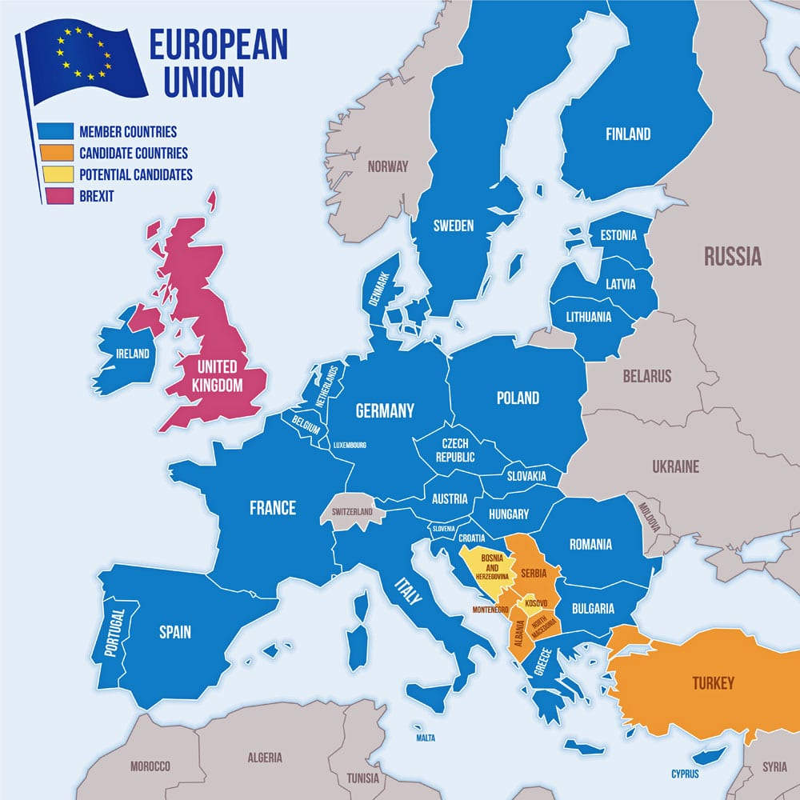

EASAC
European Academies Science Advisory Council
25 national science academies of EU member states and those of Norway, Switzerland, UK plus Academia Europaea
+ association with other networks of academies
independent science for policy advice aimed at Europe focused on three main themes:
  Environment
  Energy
  Biosciences and Public Health
Regional network of global organization

Slide 5
Presentation Nader

Slide 6




Science for policy advice by academies
Individual academies aimed at a single statement
e.g. S20 academies of G20 countries
sometimes also policy for science advice
Regional organisations like EASAC
focused on science for policy advice at continents etc
focused on topics which transcend national level
working together at global level through IAP
Individual academies
enormous diversity in strengths and roles

Slide 7
Presentations
Castro, Elmqvist and Molnár

Slide 8
Panel discussion
Helena Nader (ABC)
Science Recommendations to the G20
Rosa Castro (EASAC)
Scientific advice to address climate change’s (unequal) impacts on health
Thomas Elmqvist (EASAC)
Food production and food security in a changing climate
Zsolt Molnár (Centre for Ecological Research)
Knowledge co-production between science and traditional, indigenous and local knowledge in global science-policy fora on biodiversity
Jason Jabbour (UN Environment Programme)
The audience can ask questions to the panel during the second half

Slide 9
The multiple evidence base approach
Diverse knowledge systems contribute to generate an enriched picture
This serve as a legitimate starting point for analyses and co-production of knowledge
Tengö et al. 2014

