Slide 1
An International Hub for Advanced Science

Slide 2
ICTP’s unique mission rests on three pillars:
Excellence at the frontiers of science
Global inclusion for scientific resources
International cooperation through science

Slide 3
400+ Scientists work at ICTP from almost 100 countries
Since 1970,
190,000+
scientific visits from
188
countries around the world.
In 2023
32%
women scientists
65%
from developing countries
Every year
6,000+
visiting scientists
~60
high level conferences
Contributions to many breakthroughs including 5 Nobel Prizes.

Slide 4
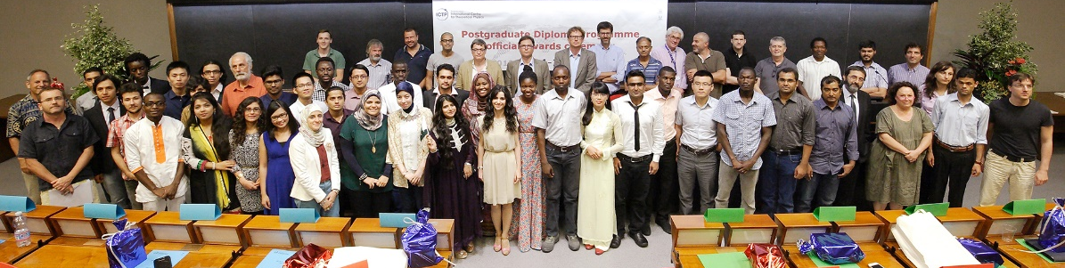
ICTP is a unique international research organization dedicated to making advanced science globally available
overcoming the barriers of
gender, ethnicity, geography, economics
This fundamental mission of ICTP now needs a newer articulation and newer modes of implementation
Notes:
Reorganize a bit with the wordings as above with better or newer picture(s). Perhaps Italicsonly for gender, ethnicity..

Slide 5
Relevance of ICTP
New realities with new nuances that we must consider
Greater need to emphasize the essential unity of pure and applied science to the public and policy makers.
Greater need to ensure equitable opportunities in the ongoing technological and scientific revolution.
Greater need to ensure essential global participation to address global challenges like Climate Change.

Slide 6
The Future of Computing and Quantum Science
The modern Scientific Method now has Computation as an important new pillar.
Growing knowledge divide when it comes to use of modern algorithms or tools like GPUs, Artificial Intelligence or Quantum Computing.
An obligation for ICTP is to find the means to make these critical resources for science globally available.
Theory
Computation
Experiment

Slide 7
International Consortium for Scientific Computing
Open Science in the coming decade must include Open Access to Computational Resources
Open Codes for High Performance Computing
Open Weights of AI algorithms
For Scientific Computing (not for self-driving cars)
An International Consortium (not a local institute) to realize this goal with global partnerships
Notes:
Line spacings after bullet points and the first line.

Slide 8
Global Science for Climate and Energy
ICTP has the mandate and the convening power as a UN organization for holding multilateral international meetings. For example, Monsoon Workshop where climate scientists from China, India, Pakistan can come together.
ICTP must help create strong scientific communities in Global South well-versed in the modern tools and modeling.
This is an essential precondition for meaningful participation in decision-making of those most affected.
Notes:
Line spacings after bullet points and the first line.

Slide 9
International Consortium for Future Earth
Effective climate response requires not only high science but also meaningful participation of the Global South.
It is essential to create a global community well-versed in the new tools also for down-stream applications.
ICTP is a unique organization that can and should play a major role building on its global network and scientific strengths.
Notes:
Consistent color and fonts. Line spacings.

