Slide 2
Engaging Researchers and Researcher Associations in Science Advice, Diplomacy and Science for Peace
Tuesday, November 19, 2024

Slide 3
What is Science Diplomacy
Diplomacy for Science
Facilitating international science cooperation
Science for Diplomacy
Using science cooperation to improve international relations between countries
Science in Diplomacy
Informing foreign policy objectives with scientific advice

Slide 4
EU SciDip Alliance Members defining SciDip
EU SciDip Survey 2023

Slide 5
Science Diplomacy in Europe
Safeguard and promote European principles and values of research
Deploy scientific cooperation in ‘the European neighborhood’
Mobilize science and diplomacy for the global commons

Slide 6
Science Diplomacy in Europe

Slide 7
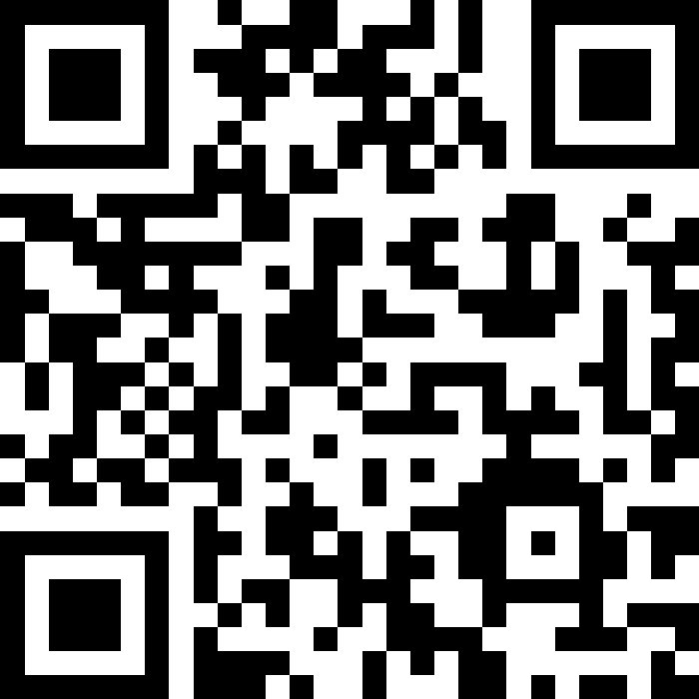
We would like to hear from you
Join at
slido.com
#1162 478

