Slide 1


State of Science Journalism
Featuring talks from the
2024 European Science
Journalist of the Year finalists.
Sponsored by

Slide 2
European Science Journalist of the Year 2024 Award
Recognising excellence and innovation
in science writing.
Sponsored by

Slide 3
European Science Journalist of the Year 2024 Award
The finalists:
Stéphane Horel,
France
Tim Kalvelage, Germany
Dora Kršul, Croatia
Sponsored by

Slide 4
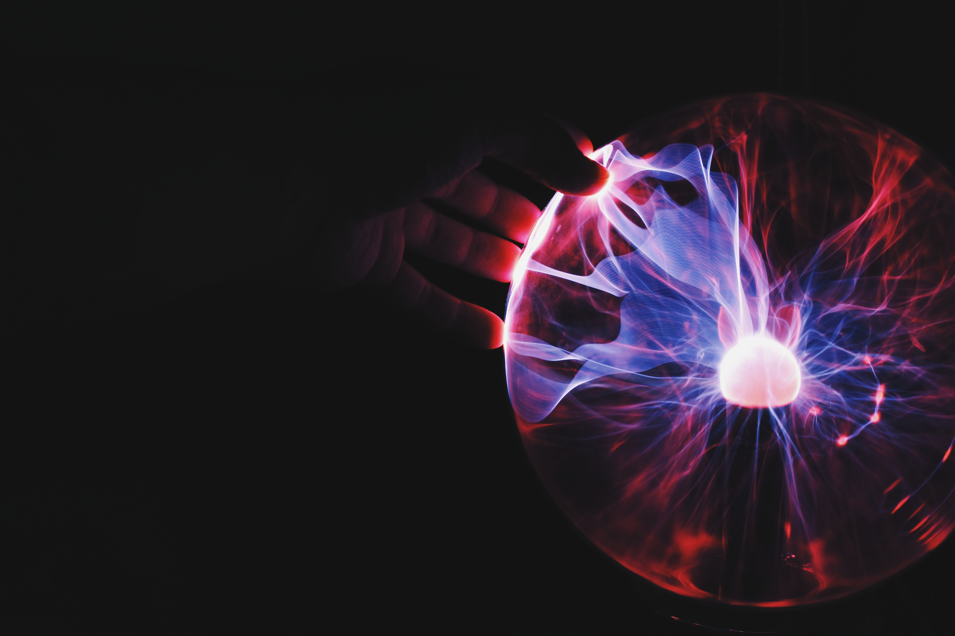
European Science
Journalist of the Year
2024 Award
Who has won
3rd prize?

Slide 5
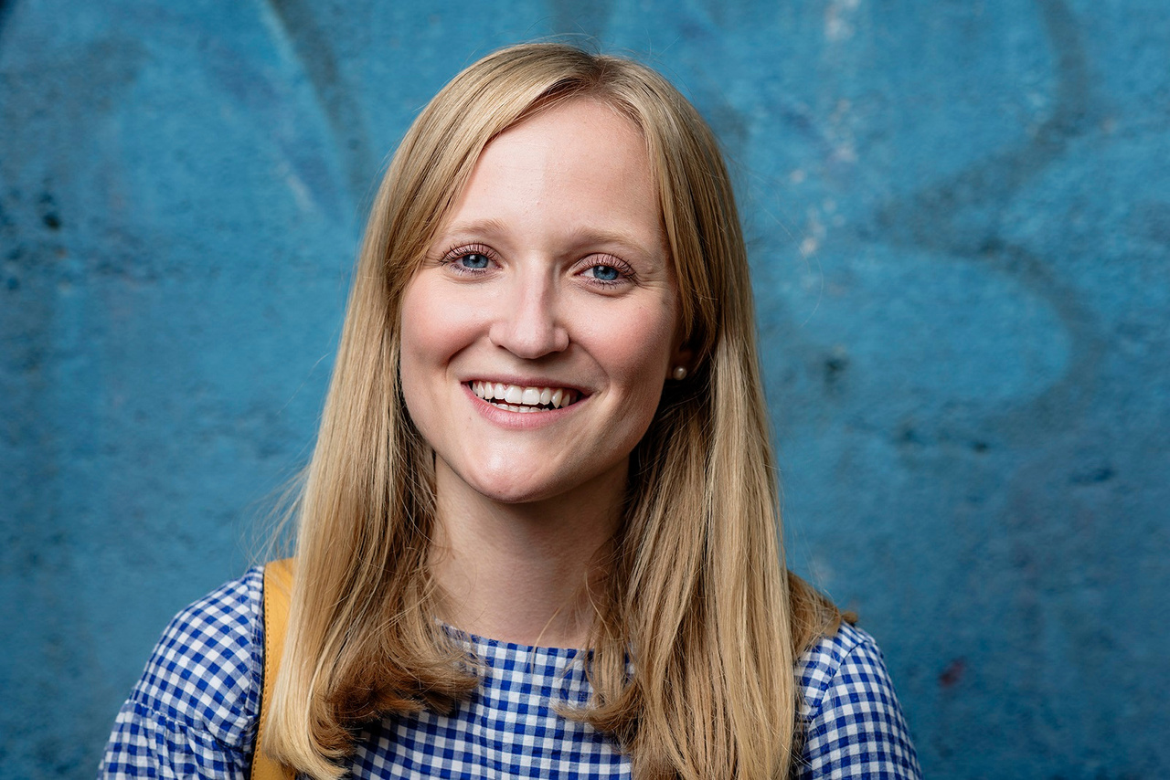
European Science Journalist of the Year 2024 Award
Runner up:
3rd prize
Dora Kršul, Croatia

Slide 6
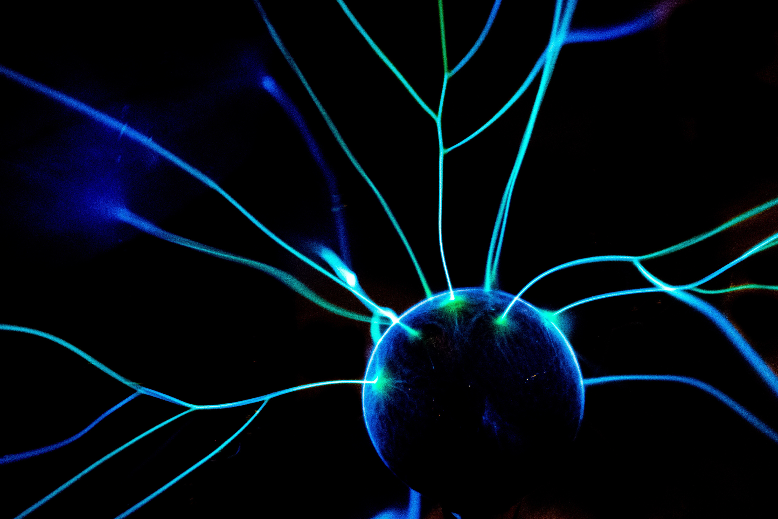
European Science
Journalist of the Year
2024 Award
Who has won 2nd prize?

Slide 7
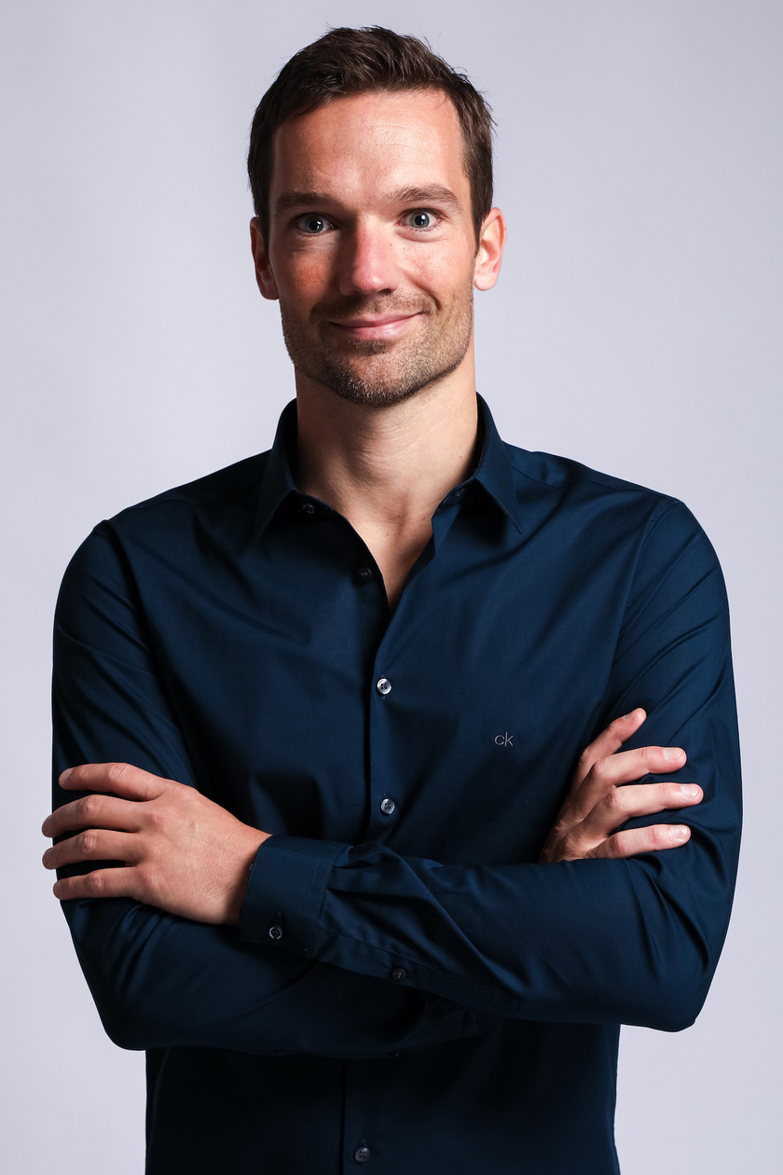
European Science Journalist of the Year 2024 Award
Runner up:
2nd prize
Tim Kalvelage, Germany

Slide 8

European Science
Journalist of the Year
2024 Award
Announcing the winner!

Slide 9
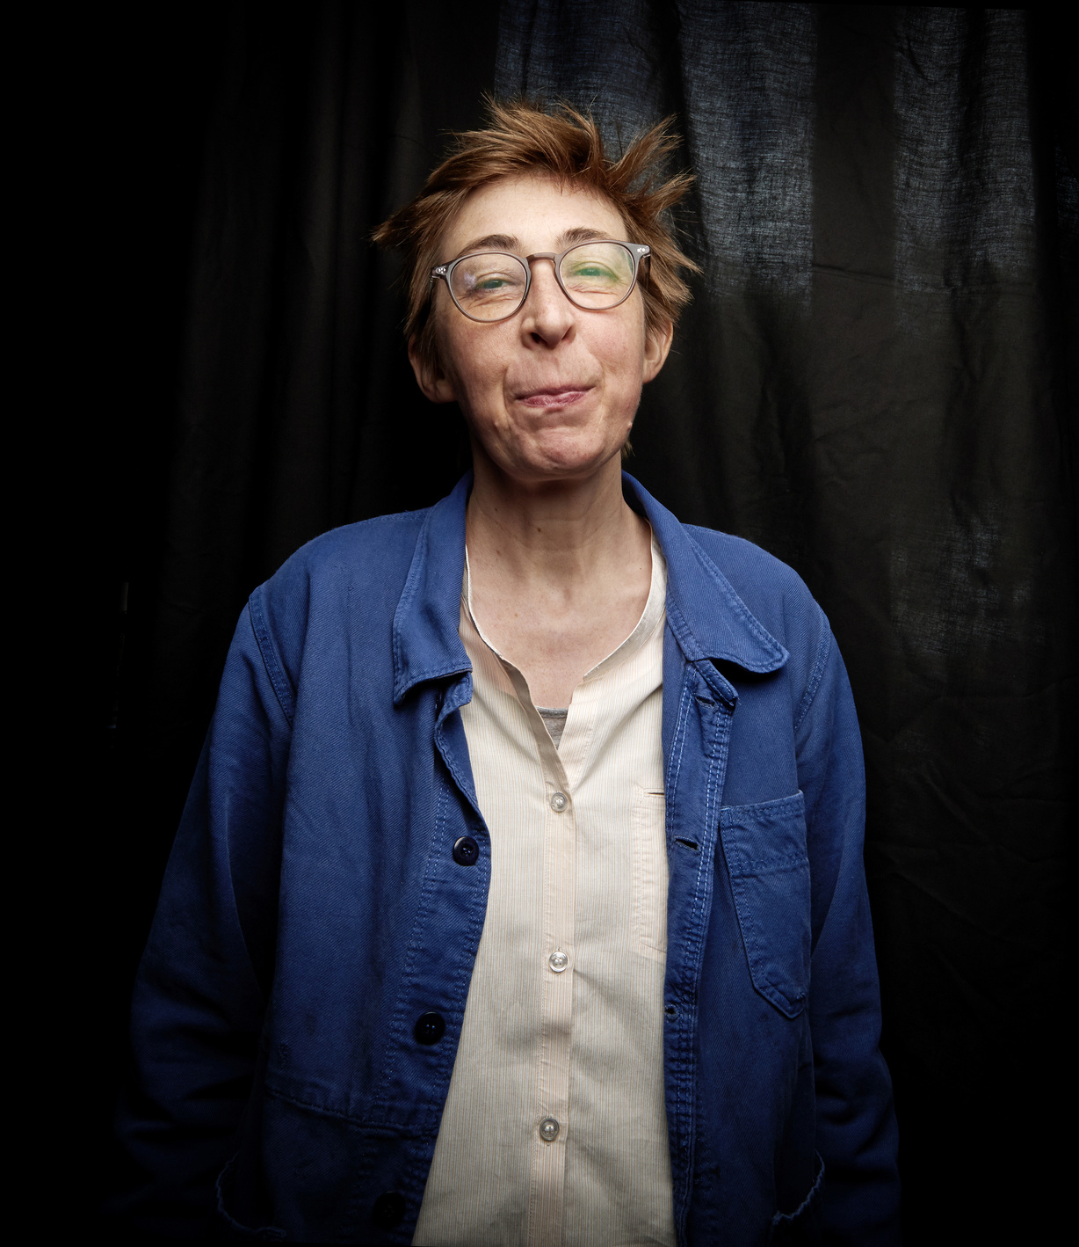
European Science Journalist of the Year 2024 Award
Winner
Stéphane Horel, France

Slide 10

European Science
Journalist of the Year
2024 Award
Congratulations to the 3 winners!

